Slide 1

Self Interest
&
Customs and Religion
Vivek Garg
CSVTU Bhilai

Slide 2
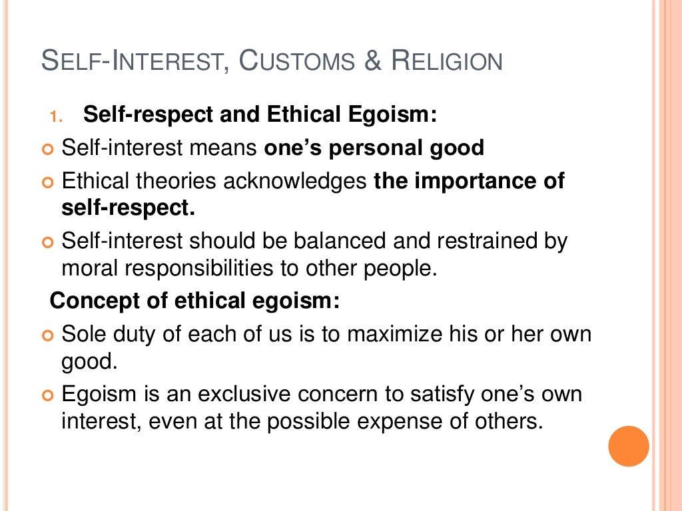

Slide 3
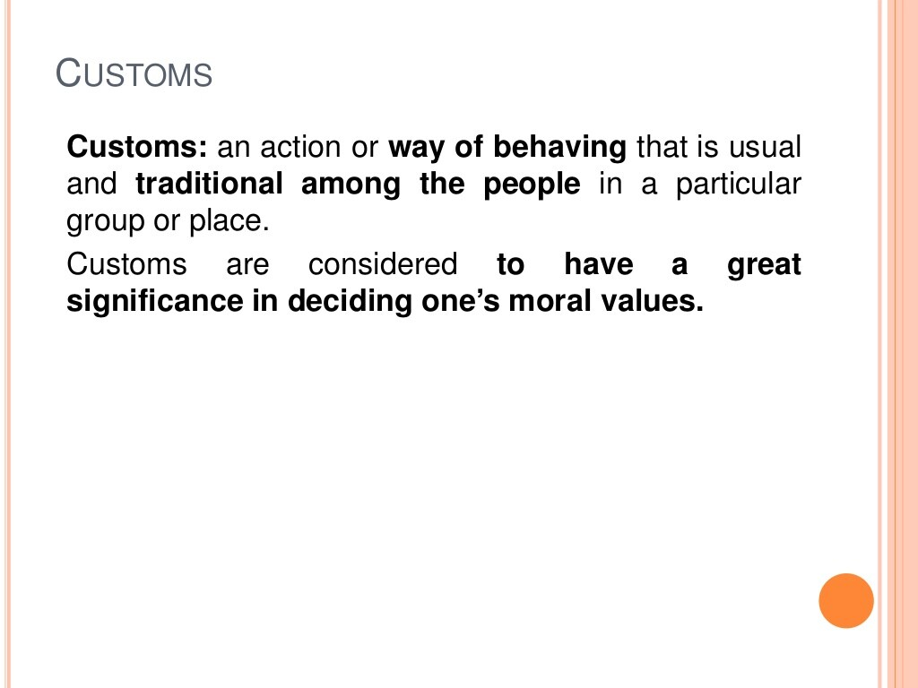

Slide 4
